Slide 1
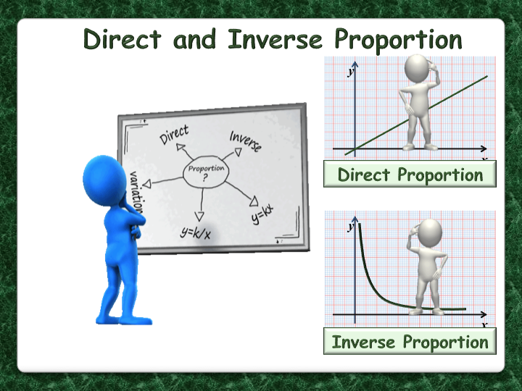
Inverse Proportion
EQ: what is inverse proportion, and can we use it to sole real life problems?

Slide 2
An Example of Direct Proportion
The more Ferrari’s I buy, the more they cost.
1 Ferrari = $400,00
2 Ferrari = $800,000
3 Ferrari = $1,200,000
That is direct proportion
Now when I Drive the Ferrari to the beach,
Driving at 20km/hr it takes 30 minutes
Driving at 40km/hr it takes 15 mins
Driving at 80km/hr it takes 7.5mins
This is an example of inverse proportion. As one value increases, the other decreases.

Slide 3


Topic : Inverse Proportion
24
7
30
Date
EQ : How do we solve problems with inverse proportion.
Inverse proportion is when 1 value increases, the other decreases.
If it takes 10 people 24 days to build a house, how long would it take 5 people?
People |  | Days
10 |  | 24
5 |  | $$x$$
$$10 ×24=5 ×x$$
240 = $5 ×x$
240 ÷ 5 = $x$
48 = $x$
It takes 5 people 48 days.
We use back tracking to solve these types of problems.

Slide 4
Lets try a these together.
A cruise ship has enough food to feed 200 passengers for 10 days.
How many days could it feed 100 passengers(D)?
200 x 10 = 100 x D
2000 = 100 x D
2000 / 100 = D
20 = D – 100 passengers could be fed for 20 days.
How many passengers could you feed for 5 days(P)?
200 x 10 = P x 5
2000 = Px5
2000 / 5 = P
400 = P – The same amount would feed 400 people in 5 days.
How many days could it last with 175 passengers?
200 x 10 = 175 x D
2000 = 175D
2000 / 175 = D
11.43 = D – the same amount of food could feed 175 passengers for 11.43 days.

Slide 5
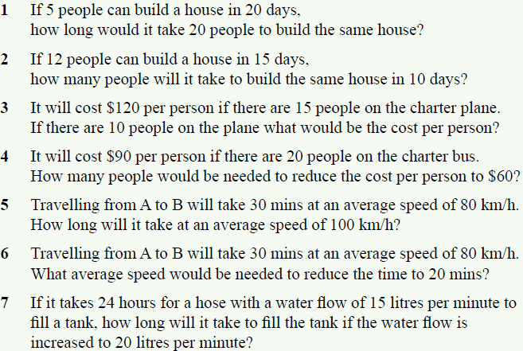
Now lets try page Ex 6.8 on Page 80

